Slide 1

“Application For Grocery Delivery”
Task - 3

Slide 2
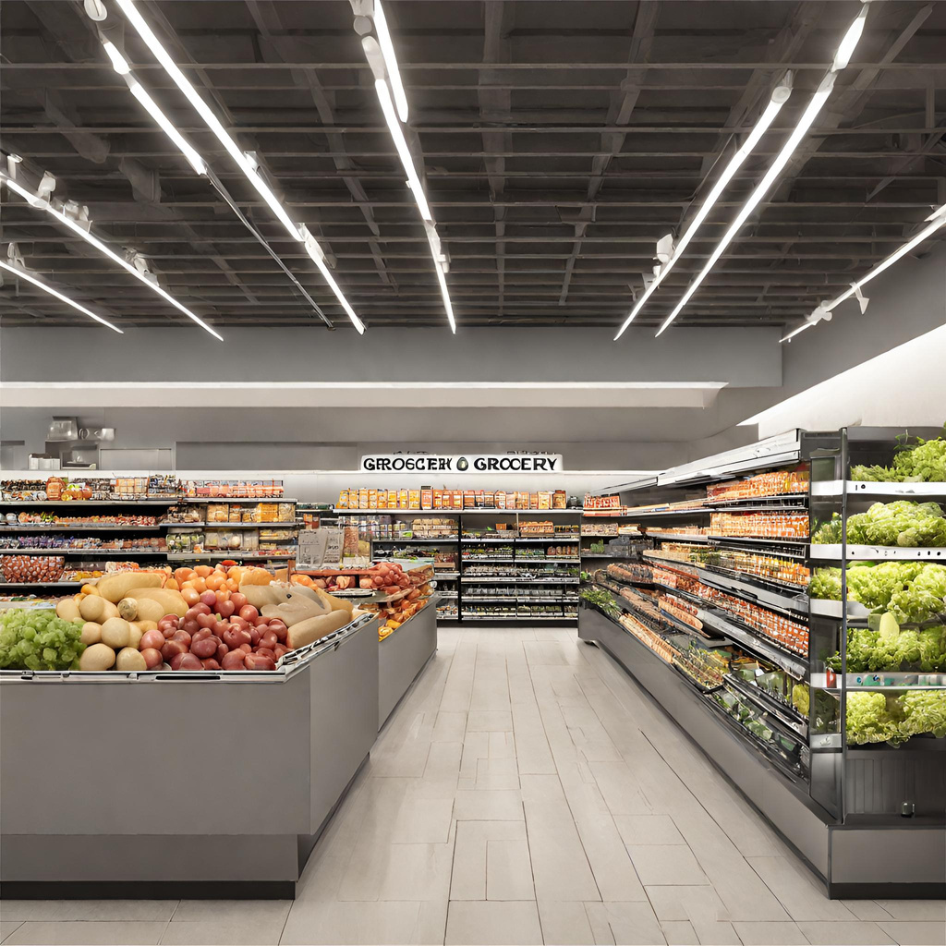
Our project introduces an innovative Grocery System, combining cutting-edge technology with industry best practices to enhance the grocery shopping experience. With a focus on operational efficiency, customer satisfaction, and inventory optimization, our system aims to modernize the grocery retail sector. By embracing the trends in online and offline shopping, we empower customers and store owners alike, creating a more sustainable and profitable grocery ecosystem.
Application For Grocery Delivery
▪
au910020104301 |  | CC2
au910020104036 |  | CC2
au910020104008 |  | CC2
LMS Username
Name
Batch
AKSHAYA G
RAJASURIYA M
ARUN S

Slide 3
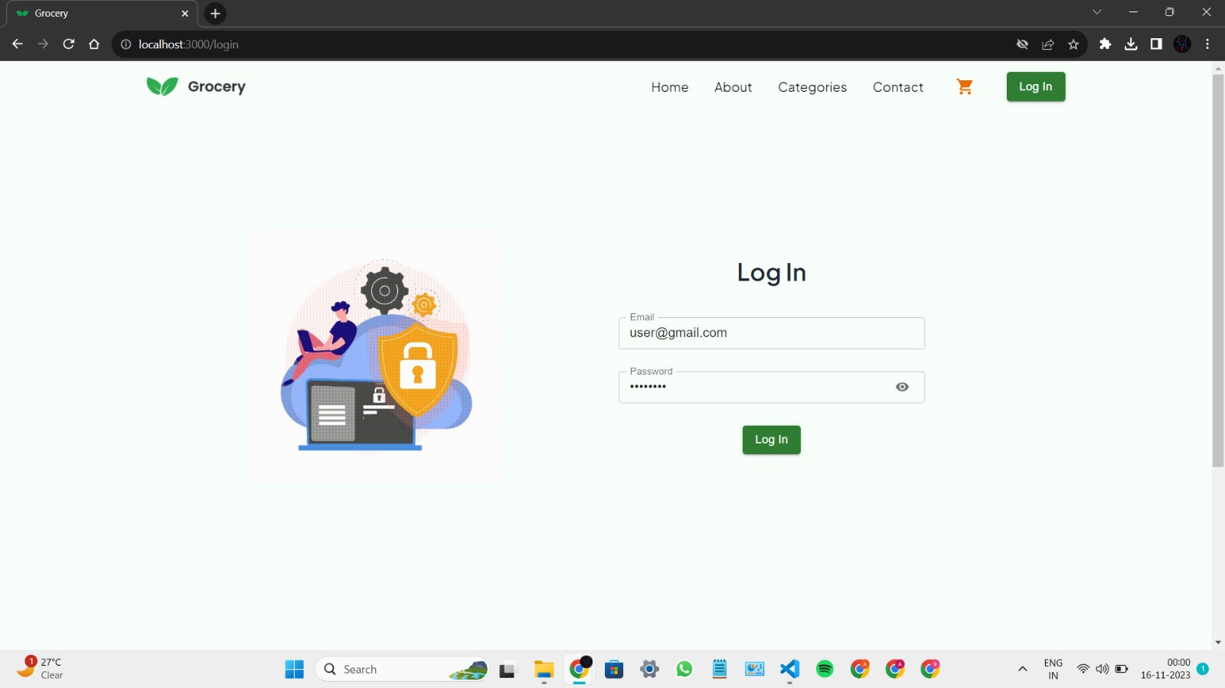
FRONT END- MODULE

Slide 4
STEP-WISE DESCRIPTION
1. Requirements:
- Identify needed features.
2. Design:
- Create UI/UX.
3. Tech Stack:
- Choose HTML, CSS, React JS.
4. Project Setup:
- Organize code structure.
5. UI Components:
- Develop visual elements.
6. Backend Integration:
- Connect via API.
7. Authentication:
- Implement login, registration.
8. Interactions:
- Enable shopping cart, interactions.
9. Testing:
- Conduct thorough tests.

Slide 5
TASK SUMMARY :
Develop a responsive and intuitive front-end for a grocery application using HTML, CSS, and ReactJS. Optimize performance by managing loading times and ensuring smooth interactions. Prioritize code quality for maintainability and readability. Implement and thoroughly test all features, focusing on effective data handling. Enhance user experience with seamless error handling and meaningful feedback. Evaluate scalability under varying loads and ensure security measures in data handling. Adhere to accessibility standards for inclusivity and test for consistent browser compatibility. Finally, provide comprehensive documentation for the codebase, covering setup and usage guidelines.

Slide 6

EVALUATION METRIC
1.UI Design :
- Responsive design for different devices.
- Intuitive and consistent user interface.
2. Performance:
- Fast loading times and smooth interactions.
3. Code Quality:
- Maintainable and readable code following best practices.
4. UX:
- Graceful error handling and user feedbacks.
5. Security:
- Secure handling of user data.
- Protection against common vulnerabilities.
6. Accessibility:
- Compliance with accessibility standards.
7. Documentation:
- Comprehensive documentation for the codebase.

Slide 7

Submission Github
Github Link
https://github.com/Suryao3/nm_modules

Slide 8


